Slide 1
Welcome to
Governors State University!

Slide 2
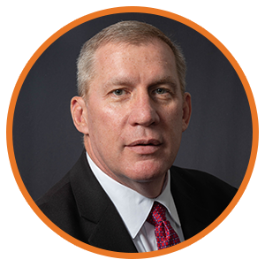
Paul McGuinness
Associate Vice President for
Enrollment Management and Athletics
pmcguinness@govst.edu

Slide 3
Campus Safety with the COVID-19
The University is committed to the health and safety of all individuals.
Nearly 80% of on-campus GSU students have uploaded their vaccination cards, and the other 20% are required to test weekly
Virtual Services are available to assist students with the admissions and enrollment process.
Campus Services
Staffing is available on campus for Admissions, Financial Aid, Registration and Dual Degree Program
Monday – Friday 8:30 am to 5:00 pm (face coverings required on campus)
We have initiated a temporary Laptop Loaner Program for students in need
Wi-Fi access in identified parking lots
We are committed to practicing social-distancing and following CDC Guidelines.

Slide 4
Welcome to Governors State University
Governors State University is one of 12 Illinois public universities. GSU’s campus is located on 750 acres, Southwest of Chicago.
US and World News ranking for Social Mobility
80 student organizations
Outstanding library databases
Computer labs and access to the Student Success Commons

Slide 5
Fast Facts
How much did American’s spend on Halloween in 2019?
- 2.6 Billion Dollars
What was candy corn originally called?
- Chicken feed
What % of all the candy sold annually in the U.S. is purchased for Halloween?
- 25%

Slide 6
Fast Facts on GSU
What was GSU’s Total Enrollment in Fall 1973?
-2,220
What is the Average Age of a GSU Freshman?
-19 Years Old
How many people visit www.govst.edu in a year?
-3 Million

Slide 7
Fast Facts on GSU
49,000 alumni
750 acre campus
70+ student organizations and clubs
4,857 students enrolled
10:1 student to faculty ratio
20 countries represented
#1 safest campus in Illinois
(www.niche.com/colleges/search/safest-colleges/s/illinois/?type=public)
8th safest campus in U.S.
(backgroundchecks.org/50-safest-colleges-in-america.html)

Slide 8
Top 10 Undergraduate Majors
Accounting, BS
Nursing, BSN
Communication, BA
Community Health, BHS
Elementary Education, BA;
English, BA;
Information Technology, BS
Interdisciplinary Studies, BA
Psychology, BA
Business Administration, BA
Criminal Justice, BA
Social Work, BSW

Slide 9
Top 10 Graduate Majors
Communication Disorders, MHS
Educational Administration, MA
Counseling, MA
Occupational Therapy, MOT
Accounting, MS
Computer Science, MS
Nursing, MSN
Social Work, MSW
Health Administration, MHA
Physical Therapy, DPT

Slide 10
Megan Chaffee
Associate Director of Financial Aid
mchaffee@govst.edu

Slide 11
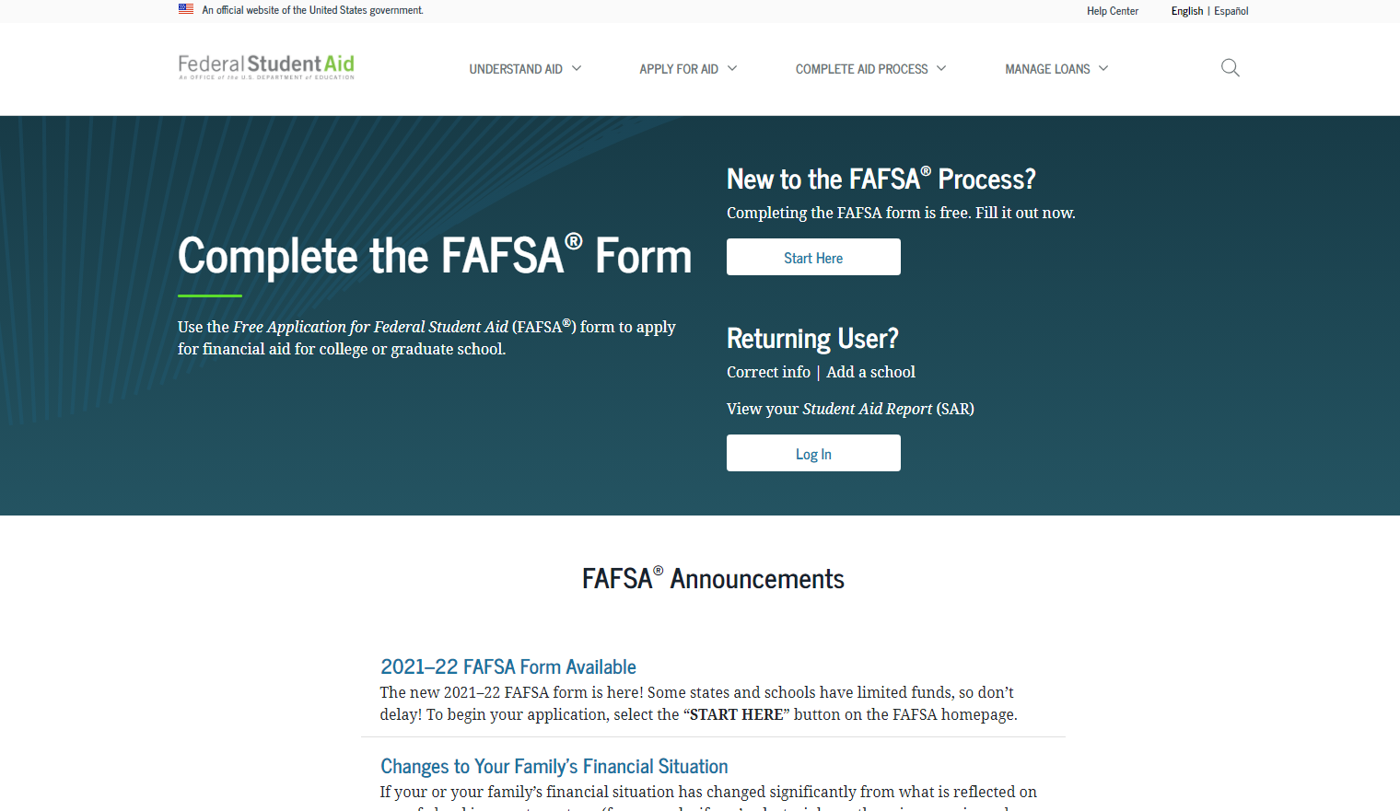
How Do I Apply for Financial Aid?
Have you done the #FAFSA?
Free Application for Federal Student Aid
Direct Link: (https://studentaid.gov/h/apply-for-aid/fafsa)

Slide 12
Types of Financial Aid
1. Grants
2. Loans
3. Scholarships
4. Student Employment Opportunities

Slide 13
Types of Grants
1. Federal PELL Grant
2. Illinois MAP Grant
3. Federal SEOG Grant
4. TEACH Grant

Slide 14
Student Loans
1. Federal Direct Loans
-Subsidized
-Unsubsidized
-PLUS
2. Private Student Loans

Slide 15
Scholarships
GSU Scholarship homepage: www.govst.edu/Scholarships/
Scholarship Universe: www.govst.scholarshipuniverse.com/public
With Scholarship Universe, Students will be able to:
• Answer questions and match to scholarship opportunities they are eligible for
• Easily apply online to multiple scholarship opportunities through a personalized portal
• See scholarship metrics to determine their chances and effort required to apply
• Be alerted whenever they are matched to new scholarship opportunities
• Receive automated reminders about outstanding tasks and next steps

Slide 16
Federal Work Study
-Employment on or off campus
-Minimum wage of higher
-Gain valuable work experience
-Work up to 30 hours per pay period

Slide 17
Office of Financial Aid
Phone: (708) 534-4480
Email: faid@govst.edu
Website: www.govst.edu/financialaid

Slide 18
Breakout Sessions
Freshman Session
Transfer Session
Graduate Session

